Slide 1
Graduate School Application
Long Shen 申龙

Slide 2
Personal Background
Overall GPA: 3.40/4.00
Major GPA: 3.63/4.00
TOEFL: 29+28+24+26=107
GRE: 152+168+4.0
Internship: 3 months in Philips Healthtech
Research: IPP (material related) & BME related
Leadership: VP of JI Student Union, Tennis Club Manager
Exchange: NCSU&UNC Joint Department BME
Projects & Awards: …

Slide 3
Application Results
School | Program | Ranking （U/P） | Results
Columbia | MS ME | 5/24 | Reject
JHU | MS ME | 11/13 | AD
UCLA | MS ME | 21/17 | Reject
DUKE | MENG BME | 9/ 6 | AD
Northwestern | MS BME | 11/12 | AD
Cornell | MENG BME | 14/17 | AD
Rice | MENG BME | 14/ 9 | AD
USC | MS BME | 21/28 | AD
CMU | MS BME | 25/30 | AD
Umich | MS BME | 28/10 | AD
Gatech | MENG BME | 34/ 3 | AD
Case Western | MS BME | 37/18 | AD

Slide 4


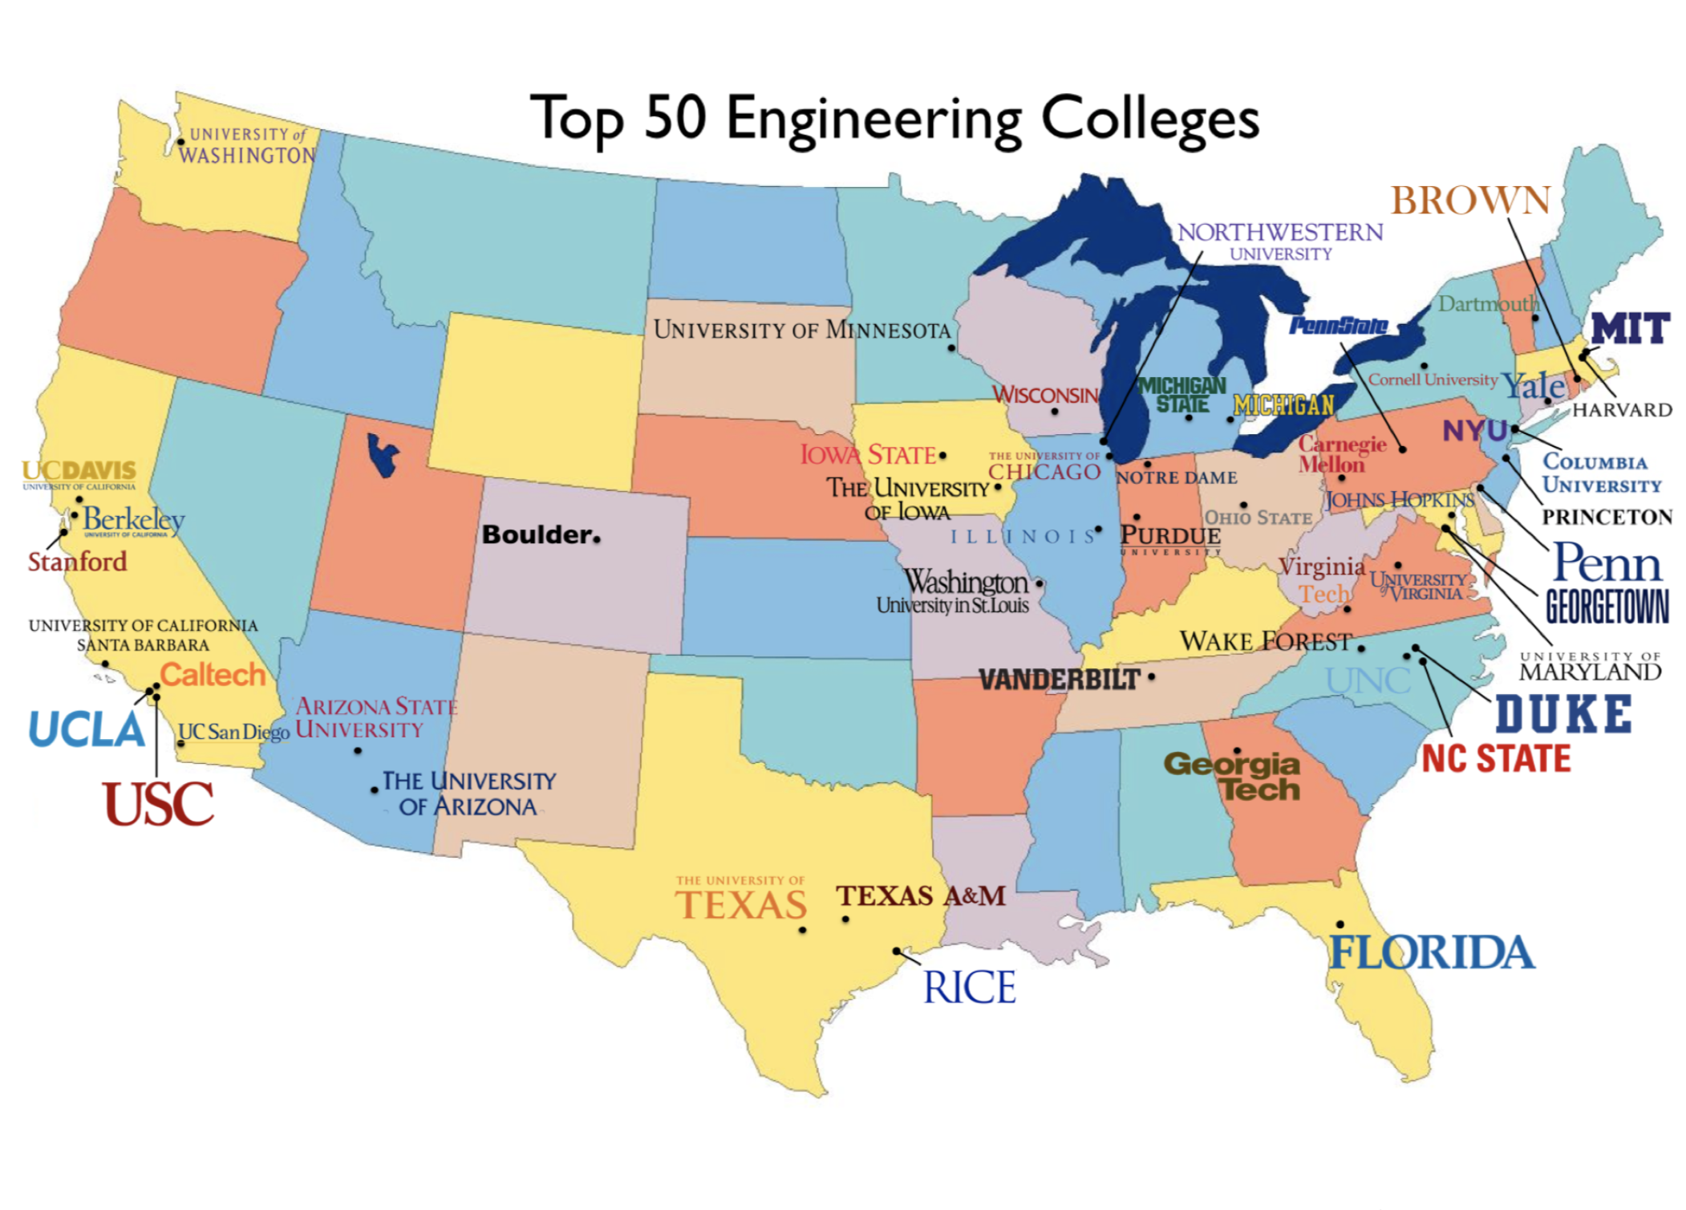

How to make choice?
Ranking
Program
Faculties
Location
Weather
Living Costs
Competitiveness
Flexibility
Others
z

Slide 5
MENG vs. MS
Master of Science:
Good for research and further study.
Usually two years.
Master of Engineering (Non-thesis Track):
Career focused, internship required.
Most MENG programs are one year long.
https://zhuanlan.zhihu.com/p/28443915

Slide 6
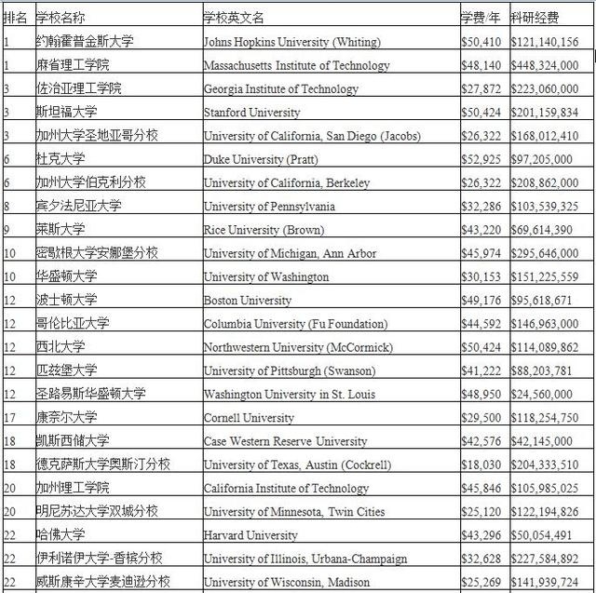
BME
Interdisciplinary Major:
BIO EE CE ME CS
Medical

Slide 7
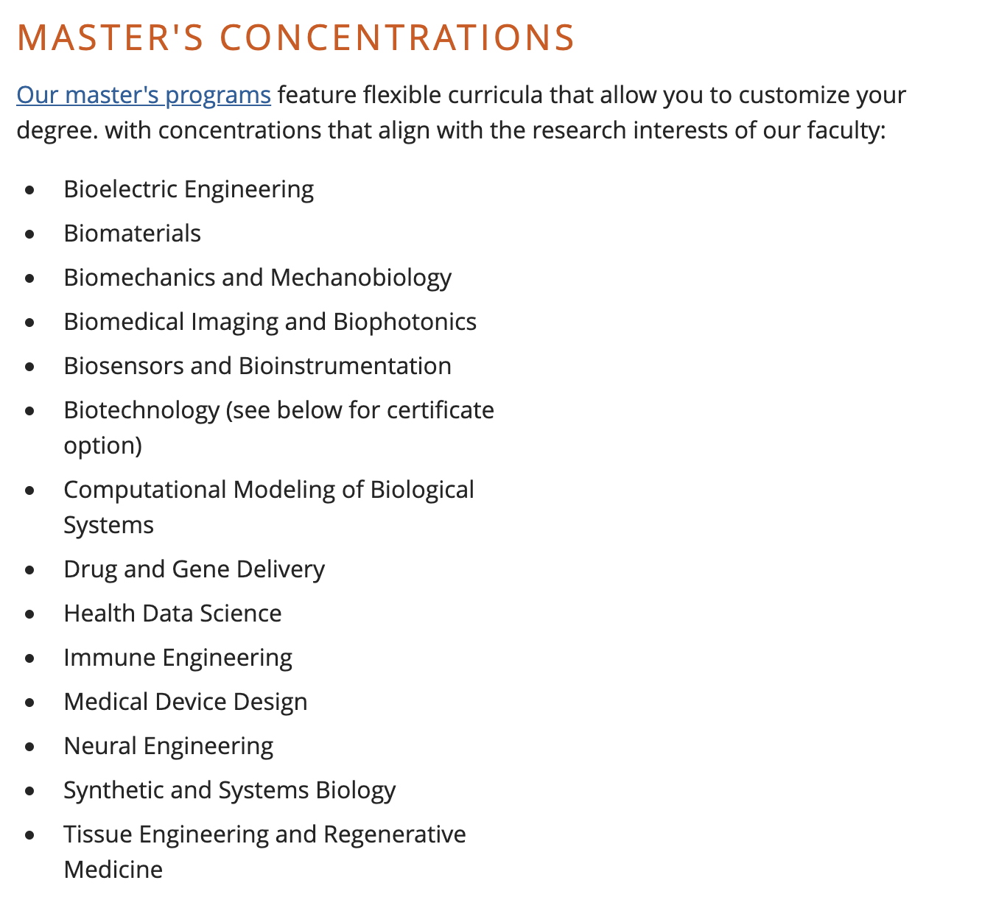
BME
Lots of concentrations:
(Taking DUKE for example)

Slide 8
What I have done
Taking BME related course:
VM458 Biomedical Instrumentation and Design
Override and overload
Exchange Program:
Take more courses in BME Department, get good grades
Find BME related research and get a recommendation letter
Take TOEFL test (GRE suggested)
Internship:
Learn field related developing trend, get the 2nd recommendation letter
Research:
IPP Material related, get the 3rd recommendation letter, taking my recommender’s course

Slide 9
TOEFL and GRE Test
Your TOEFL score expires after 2 years from your test date.
GRE is not as important as you might think.
A total score of 320-324 makes no difference. If you want good grades, recite vocabulary from now on.
152+168 is better than 150+170
For engineering student, high writing score is not demanded, 3.0 is enough, 3.5+ is preferred.
One can only take up to 5 GRE tests in a year.

Slide 10
Application Materials
Resume: precise and concise
Show your rank if you are top student, vice versa.
List your Major GPA.
Include important projects you have done.
PS/SOP: show your strong motivation and what you have done
try to make a connection between the projects/researches you have done with study plan
Recommendation Letter: show you abilities from different aspects
Others

Slide 11
After Submission
Often Check your mail box, you might receive interview invitation.
When doing the interview, make sure you have good internet connection. This is very important.
Usually it is a good news if you receive interview invitation.
Columbia University requires you to take a digital interview
Duke University requires a simple (causal) video chat
Rice University has two rounds of interview, which is a little tougher.

Slide 12
Some Useful Tips
Make excels, listing all the schools, programs, URL, account, application due date etc.
Use SJTU mail or Outlook/ Gmail/ Hotmail
Exchange Program and Summer Research are helpful if you have the time and energy to do one.
Be ambitious and play safe when selecting target universities.
Start early! Especially when you ask for RLs.
Do the capstone project in fall semester and you can add it to your resume.

Slide 13
Q&A
Email: shenlong19961126@163.com

